Slide 1
The Socket API
Shyan-Ming Yuan
CS Department, NCTU
smyuan@gmail.com

Slide 2
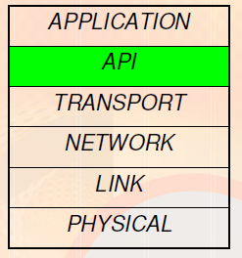
What is an API?
Application Programming Interface.
Interface to what?
Socket API is an interface to use the network.
A connection to the transport layer.
Functions at transport layer and below are very complex.
E.g. Imagine having to worry about errors on the wireless link and signals to be sent on the radio.

Slide 3
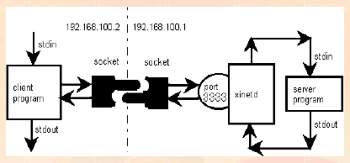
What is a Socket?
It is an abstraction that is provided to an application programmer to send or receive data to another process.
Data can be sent to or received from another process running on the same machine or a different machine.

Slide 4
The Socket API
The Socket API was originated released with the 4.2 BSD system in 1983 - Berkeley Sockets
It is like an endpoint of a connection
It exists on either side of a connection and is identified by IP Address and Port Number.
It is a way to speak to other programs using UNIX file descriptors.
A file descriptor is an integer associated with an opened file (or a network connection).
Types of Internet Sockets
SOCK_STREAM (TCP): Connection oriented and Reliable
SOCK_DGRAM (UDP): Connectionless and Unreliable

Slide 5
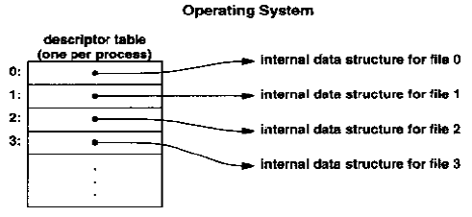
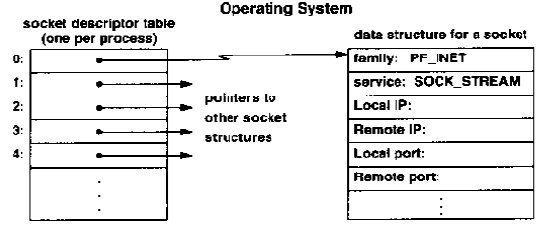
File & Socket Descriptors

Slide 6
Endpoint Address in Socket
The socket system defines a generic format for specifying an endpoint address.
struct sockaddr { // struct to hold an address
uint8_t sa_len; // total length
sa_family_t sa_family; // address family, AF_xxx
char sa_data[14]; // 14 bytes of address
};
struct sockaddr_in { // struct to hold an address for internet
uint8_t sin_len; // total length
sa_family_t sin_family; // address family
u_short sin_port; // port number
struct in_addr sin_addr; // IP address
char sin_zero[8]; // unused
};
struct in_addr { unsigned long s_addr; // 32-bit long, or 4 bytes };
Struct sockaddr_storage {
uint8_t ss_len; // length of this struct
sa_family_t ss_family; //address family

Slide 7
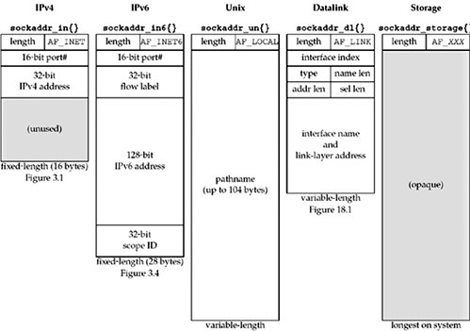
Socket Address Structures

Slide 8
Network Byte Order Conversions
Network byte order is big-endian byte order
htons() – "Host to Network Short“
htonl() -- "Host to Network Long“
ntohs() -- "Network to Host Short“
ntohl() -- "Network to Host Long“
inet_addr() converts a dotted decimal IP address into unsigned long in network byte order
ina.sin_addr.s_addr = inet_addr(“129.110.43.11”);
int inet_aton(const char *cp, struct in_addr *inp)
A better way to converts a dotted decimal IP address into unsigned long in network byte order
inet_ntoa() returns a string from a struct of type in_addr
char *s = inet_ntoa(ina.sin_addr);

Slide 9
Socket Functions
socket() – create a socket
bind() – bind a socket to a local IP address and a port number
connect() – connect to a remote host
listen() – wait for someone to connect to my port (used by servers)
accept() – accept a new connection and get a new socket for subsequent data transmissions
send() and recv() – Send and receive data over a connection
int send(int sockfd, const void *msg, int len, int flags);
int recv(int sockfd, void *buf, int len, int flags);
read() and write() – Send and receive data over a connection
read / write a particular number of bytes from a socket

Slide 10
More Socket Functions
sendto() and recvfrom() – Send and receive data without connection
int sendto(int sockfd, const void *msg, int len, int flags, const struct sockaddr *to, int tolen);
int recvfrom(int sockfd, void *buf, int len, int flags, struct sockaddr *from, int *fromlen);
close() and shutdown() – close a connection Two way / One way
getpeername(int sockfd, struct sockaddr *addr, socklen_t *addrlen);
Useful to obtain the peer name given the socket file descriptor
gethostbyname(const char *name); – obtain IP address of a computer
getservbynament (const char *name, const char *proto);
Useful to get the port number given a struct of type sockaddr
getprotobyname(const char *name); -- obtain the protocol number
getaddrinfo(void *hostname, void *servicename, struct addrinfor *hints, struct addrinfor **result);
Useful to obtain IP address and port number of the server
It is a better way than the combination of get-host-serv-proto-bynames

Slide 11
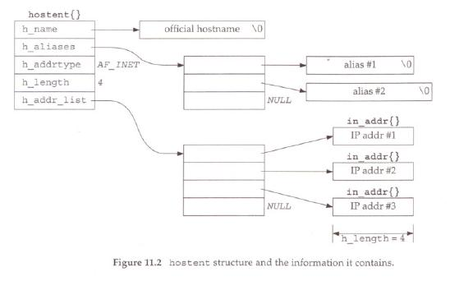

Slide 12
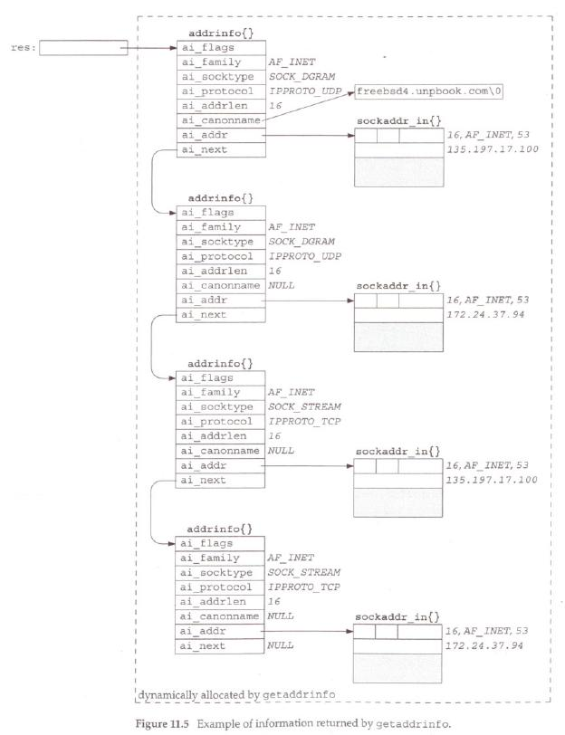

Slide 13

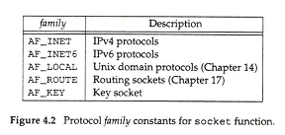
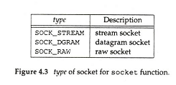
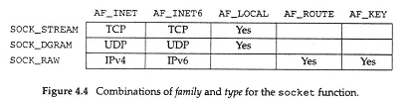
The socket function call

Slide 14
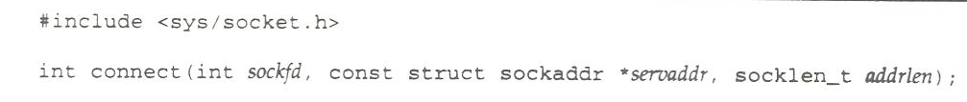
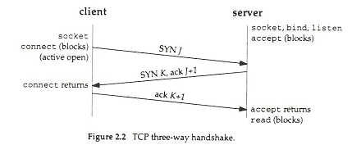
The connect function call
In TCP, It is used by a client to establish a connection with a server.
In UDP, it is used by a client to record the IP and port of a server.

Slide 15
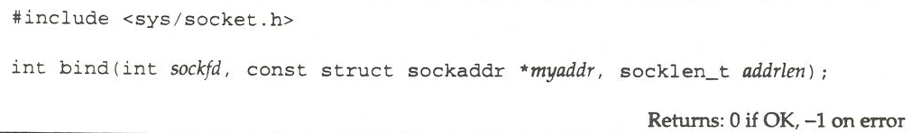
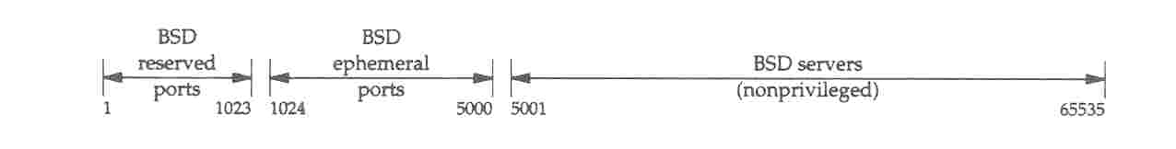
The bind function call
The bind assigns a local protocol address to a socket.
In the internet protocol, the address is the combination of
either a 32-bit IPv4 address or a 128-bit IPv6 address with
a 16-bit TCP or UDP port number.

Slide 16
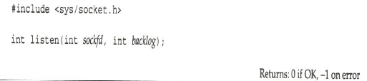
The listen function call
The listen converts an unconnected TCP socket into a passive mode for awaiting incoming connection requests.
The backlog argument specifies the maximum number of connection requests can queued for this socket.
The listen can only be used by an awaiting TCP server process.
The listen is normally called after socket and bind function calls and must be called before the accept function call.

Slide 17
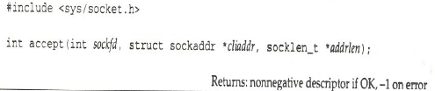
The accept function call
The accept function is called by a TCP server to return the next completed connection from the connection request waiting queue.
If there is no completed connection, the calling process is put to sleep until a completed connection exists unless the socket is noblocking.

Slide 18
The host address functions
#include <arpa/inet.h>
Int inet_aton(const char * strptr, struct in_addr *addrptr);
Returns: 1 if string was valid, 0 one error
In_addr_t inet_addr(const char * strptr);
Returns: 32-bit IP address in NBO; INADDR_NONE if error
Char *inet_ntoa(struct in_addr *addrptr);
Returns: pointer to dotted decimal IP
Although the dotted-decimal 255.255.255.255 is used as a valid broadcast address, it can not be handled by inet_addr().

Slide 19
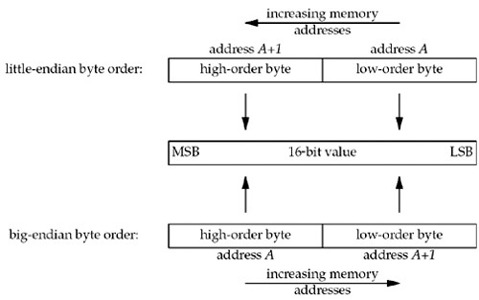
Big and Little Endian Byte Orders

